Slide 1


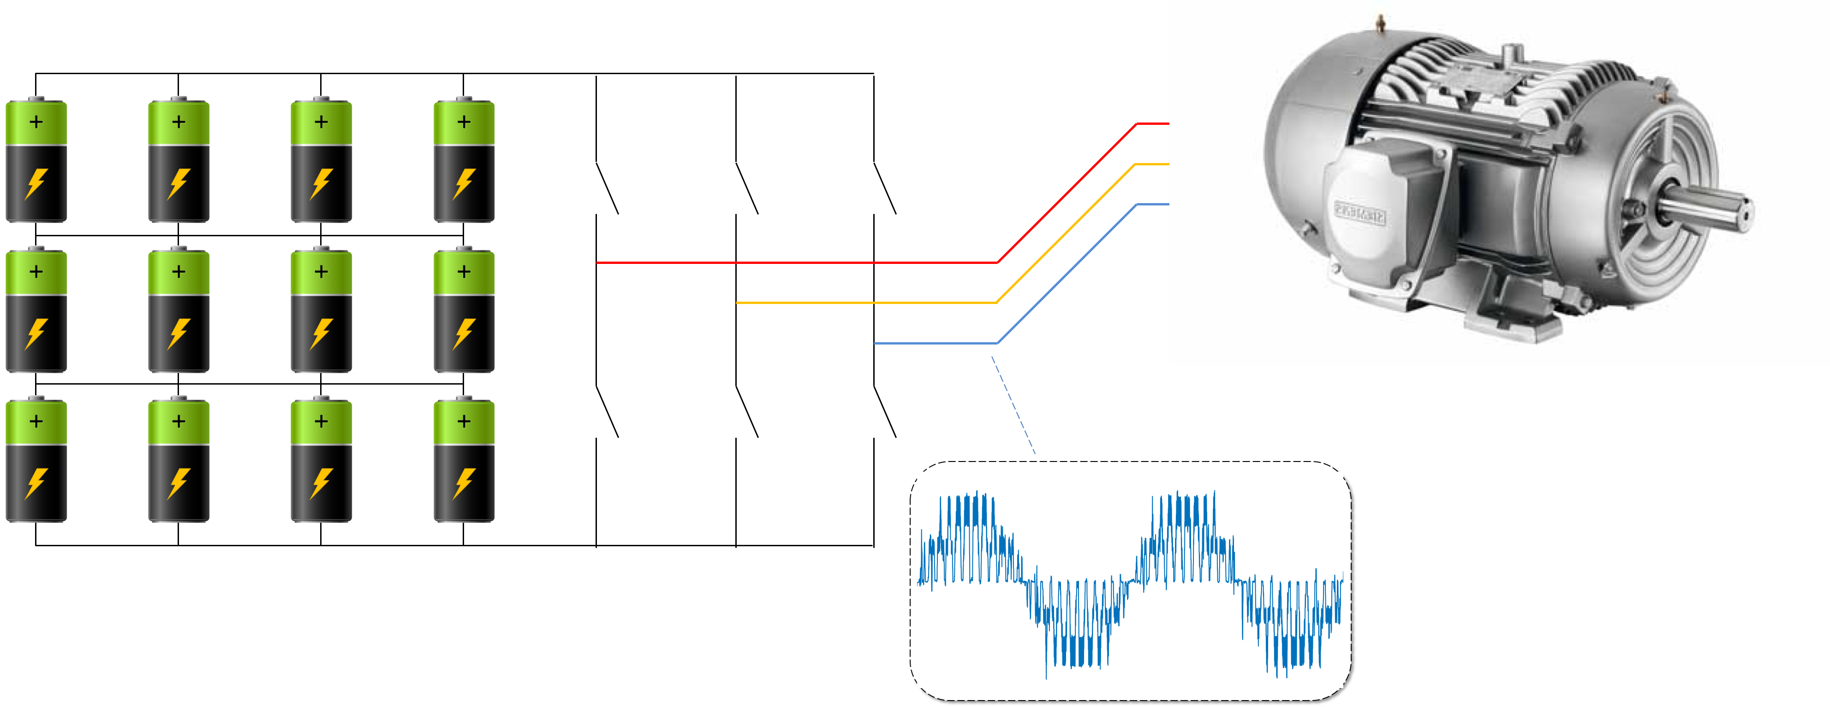
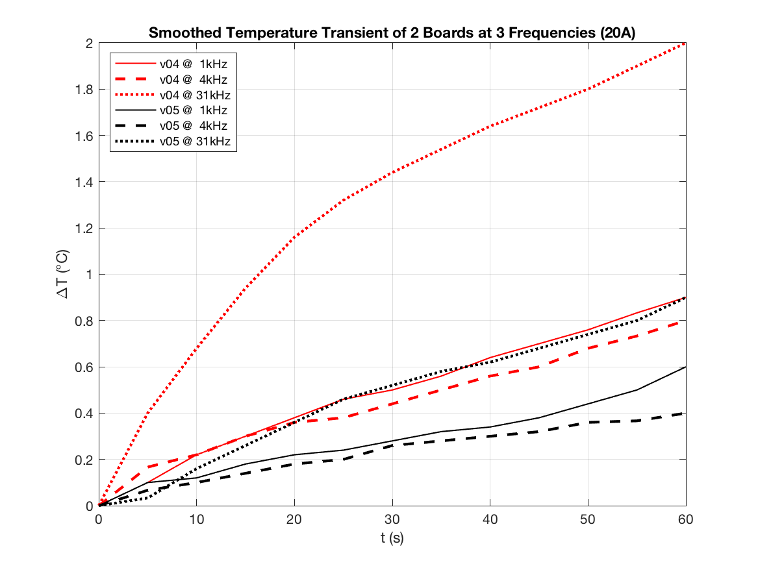
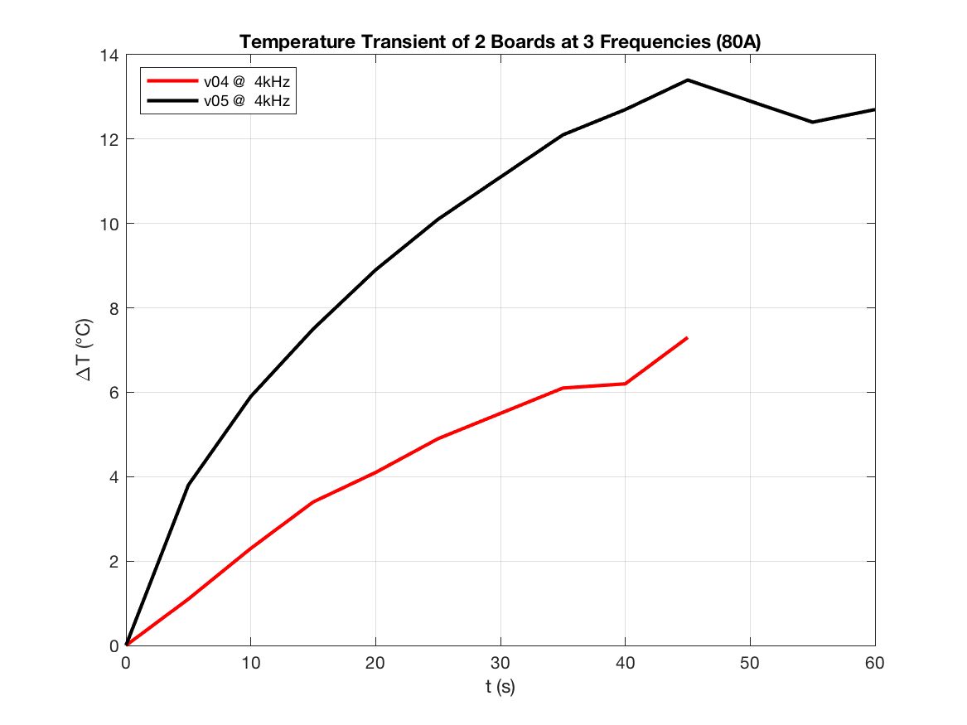
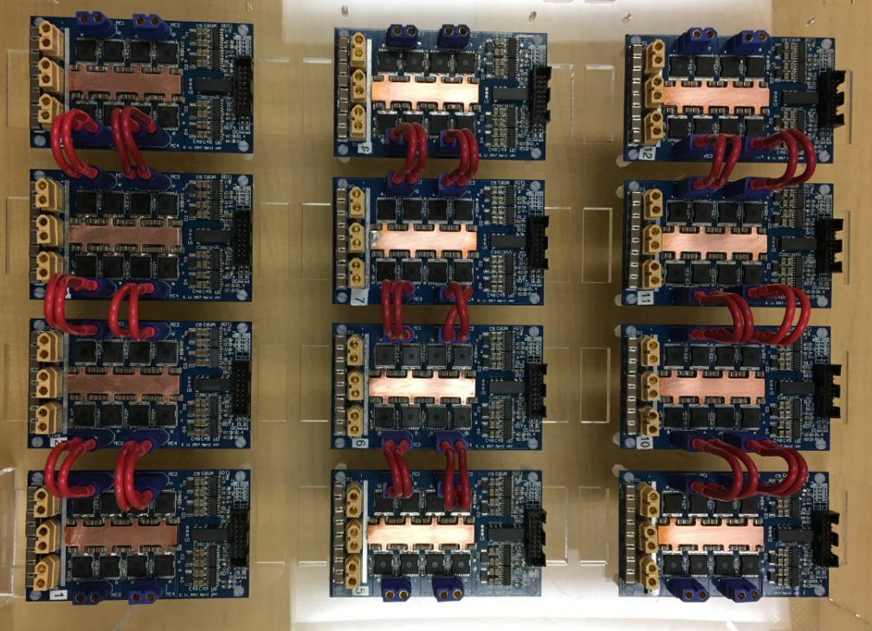

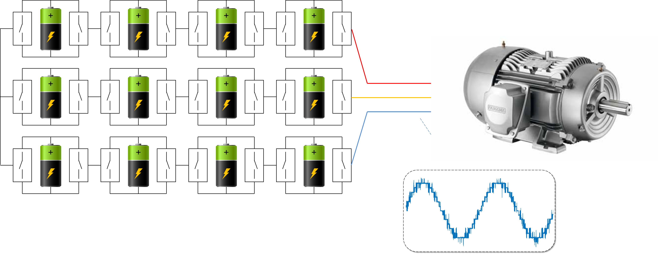
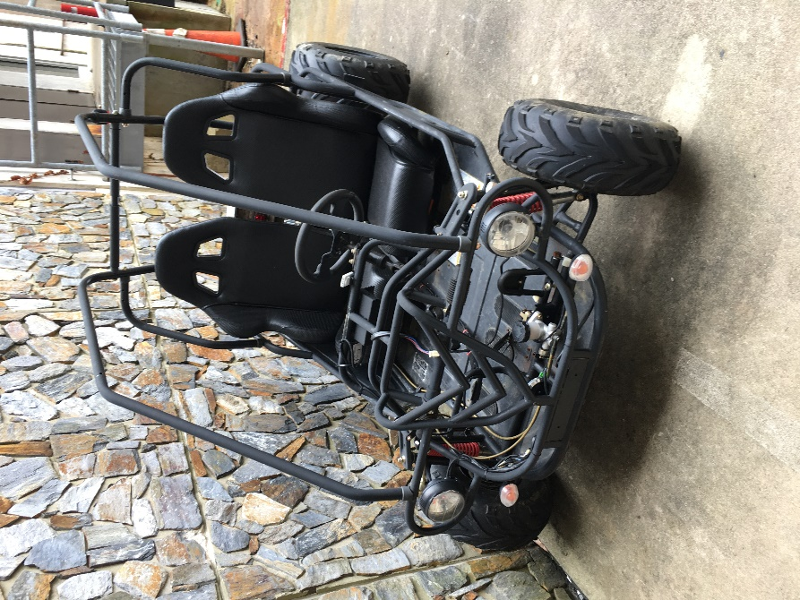

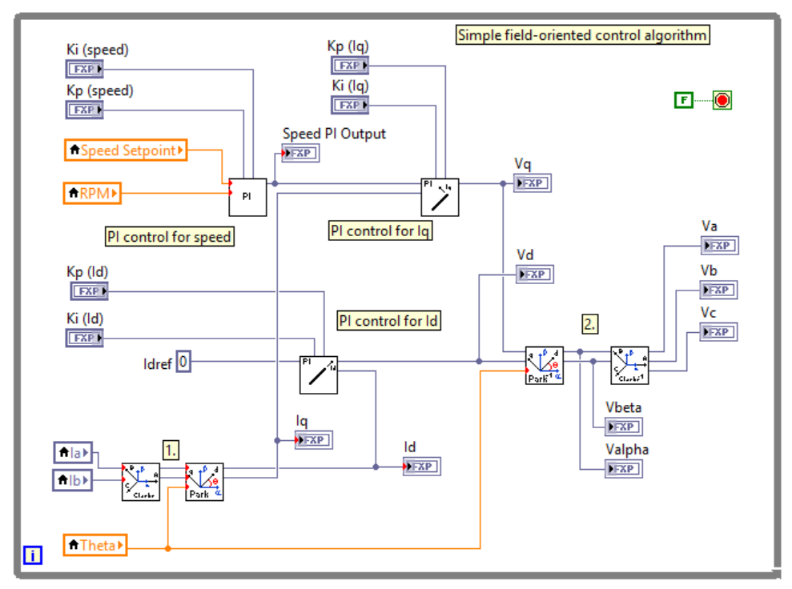

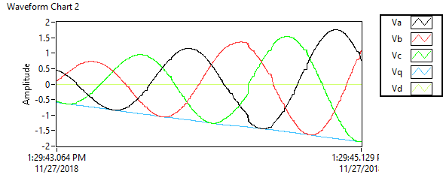
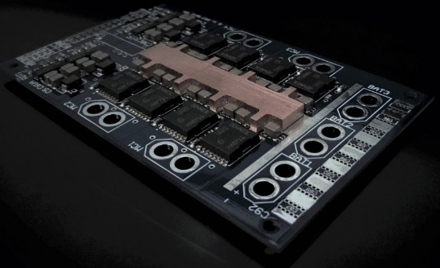
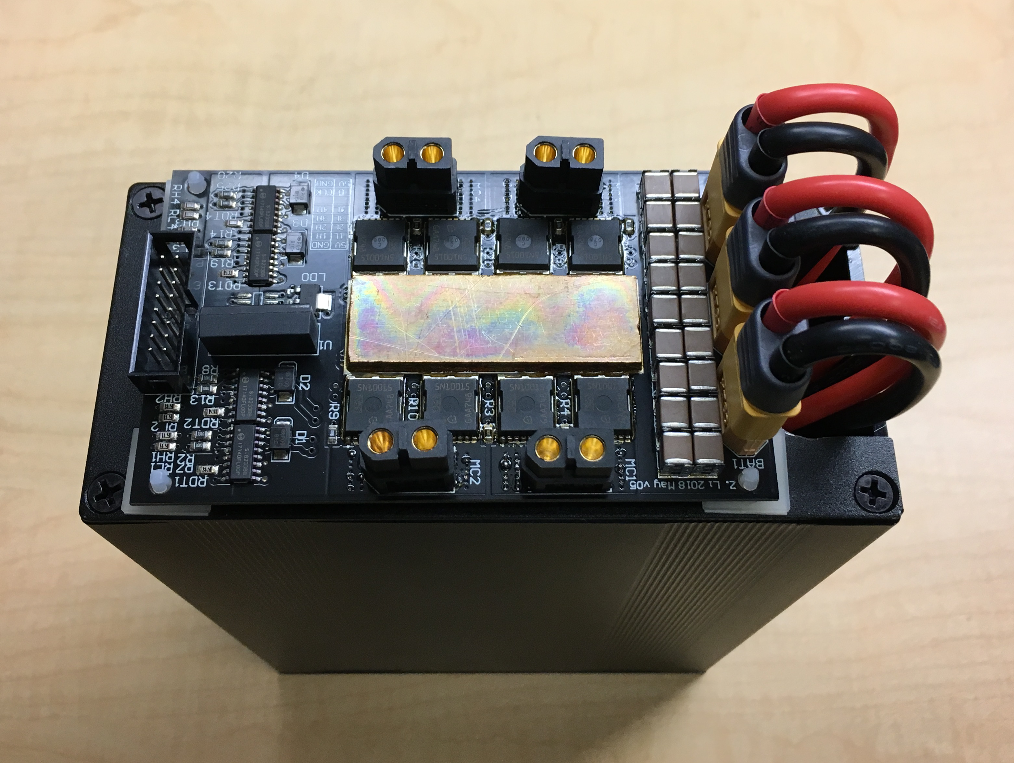
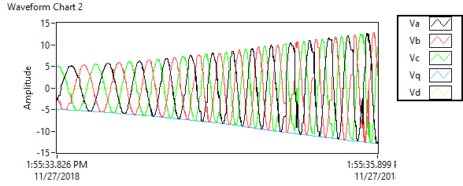
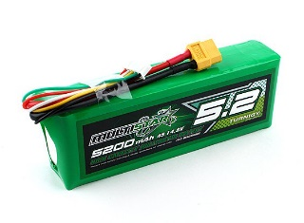
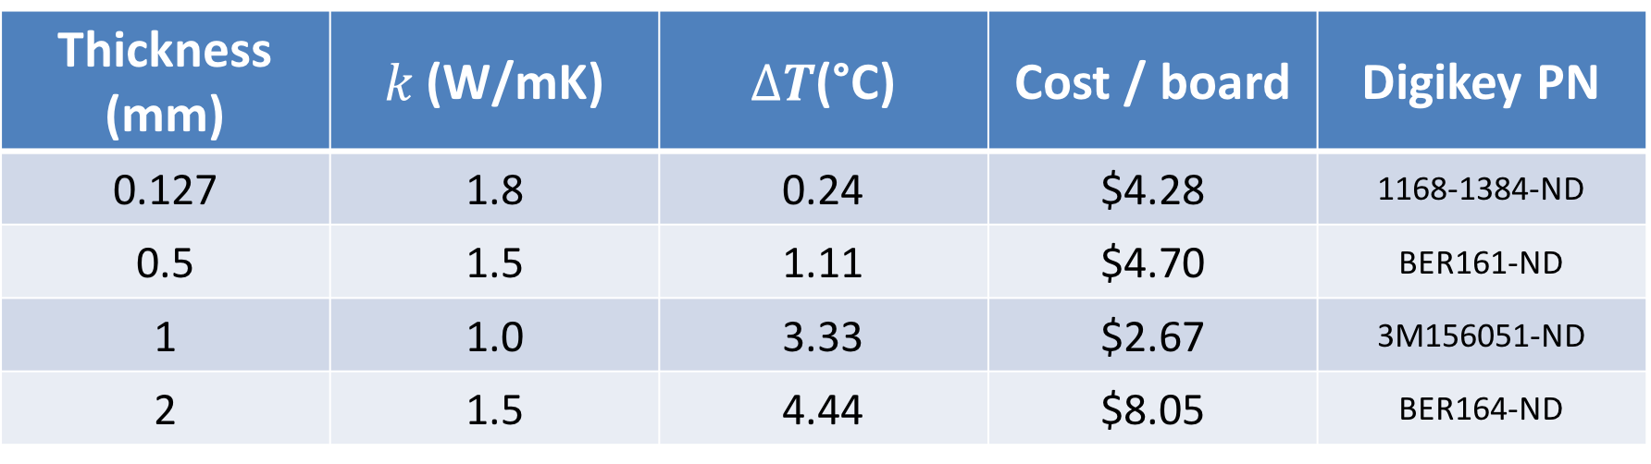
Automotive Application of an Advanced Power Conversion for Brushless Motor Control Gerry Chen, Zhongxi Li, Carol Xia, Raj Borra, Sam Osheroff, Angel Peterchev, Stefan Goetz Duke University, Durham, USA
State of Art Electrical Vehicle and Problems
Electrical & Thermal Testing
Future Work : Assembly
Hard-wired batteries
Bad fault-tolerance
Needs complex battery management circuit
Controller
Output distortion
Large EMI
Motor
Large torque ripple
Large noise
Large insulation stress
MOSFET selection:
Frequency and dead-time: ~4kHz optimal
Losses dominated by R_{DS}
Thermal capacity of copper sufficiently large
Our Solution : Intelligent Battery Modules
Thermal Pad Comparison
Thickness (mm) | $k$ (W/mK) | $∆T$(°C) | Cost / board | Digikey PN
0.127 | 1.8 | 0.24 | $4.28 | 1168-1384-ND‎
0.5 | 1.5 | 1.11 | $4.70 | ‎BER161-ND‎
1 | 1.0 | 3.33 | $2.67 | ‎3M156051-ND‎
2 | 1.5 | 4.44 | $8.05 | ‎BER164-ND‎
Motor Control
Modular batteries ^{[1]}
Battery interfaced by switches
Smart control ^{[2]}
Sensor-less balancing
Minimal losses
Field-Oriented Control takes full advantage of precise current control ability
High-quality output
Less toque ripple
Less insulation stress
Great fault-tolerance
Module Design
References
High-power circuit
Intelligent battery module
Stable operation for setpoint and sensed speed changes
[1] Goetz, Stefan M., et al. "Control of Modular Multilevel Converter With Parallel Connectivity—Application to Battery Systems." IEEE Transctions on Power Electronics 32.11 (2017): 8381-8392.
[2] Z. Li, A. V. Peterchev, R. Lizana, and S. M. Goetz, “Distributed Balancing Control for Modular Multilevel Series/Parallel Converter with Capability of Sensor-less Operation,” in Energy Conversion Congress and Exposition (ECCE), 2017 IEEE, 2017.
LiPo batteries

